Slide 1
Intro to p5.js
Developed by Jerusha, Patti and Saranii

Slide 2
What is p5.js?

Slide 3
p5.js is a JavaScript library for developing creative coding projects.

Slide 4
A JavaScript library
is a collection of prewritten code snippets that can be used and reused in developing coding projects.

Slide 5
Coding projects using p5.js can be
Art projects
Animation Projects
Digital Story Projects
Game Projects
& many others

Slide 6
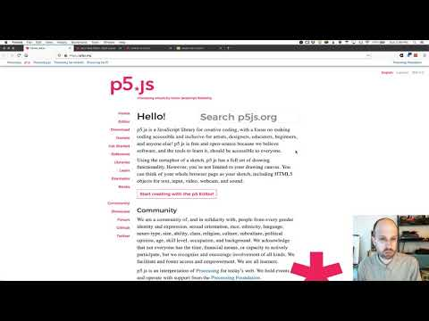
Coding with p5.js video…

Slide 7
Let’s get started with p5.js !

Slide 8
STEP 1
Open your p5.js editor

Slide 9
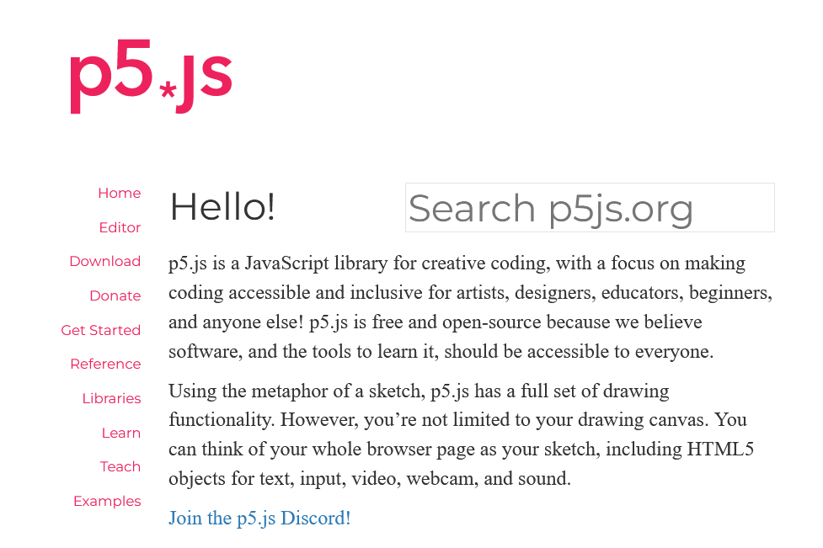
Go to https://p5js.org/
then
select Editor

Slide 10
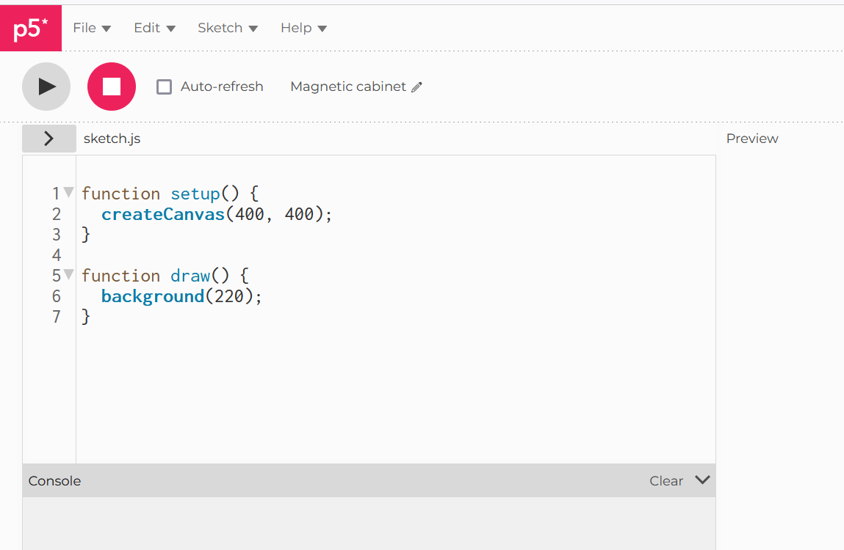
https://www.youtube.com/watch?v=feGdJFh02YQ&t=63s
STEP 2
Learn
the p5.js interface

Slide 11
TERMS
TOOLBAR
File
Edit
Sketch
Help

Slide 12
TERMS
ICONS
Play
Stop
File Tree

Slide 13
TERMS
WORKSPACES
Code Space
Preview Space
Console

Slide 14
TERMS
WORKSPACES
Code Space
Where I will type, build/develop and debug my (p5.js, HTML and or CSS) code.

Slide 15
TERMS
WORKSPACES
Preview Space
Where I will see the outcome of my (p5.js, HTML and or CSS) code that I built in the code space after I select the
button.

Slide 16
TERMS
WORKSPACES
Console
Where I will see error messages to guide debugging efforts in my (p5.js, HTML and or CSS) code after I select the
button.

Slide 17
STEP 3
Let’s get coding with p5.js

Slide 18
p5.js
(
Open Parenthesis
,
Comma
)
Closed Parenthesis
/
Forward slash
{
Open Curly Brace
;
Semicolon
}
Closed Curly Brace

Slide 19
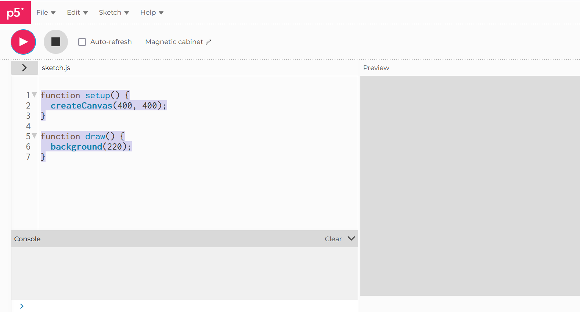
p5.js: CREATING A CANVAS
function setup() {
createCanvas(400, 400);
}
function draw() {
background(220);
}
QUESTION: What do you notice?

Slide 20
p5.js: CREATING COMMENTS
Two forward slashes Include your comment
EXAMPLES_____________________________________________________
// I created a comment to help keep track/define
// or add notes about the code to help in debugging

Slide 21
TIPS:
Auto Save
Comment your code
Debug
Duplicate
Take an (i) break
Get a second look aka collaborate!
Have fun superstar!

Slide 22
PROJECT 1:
Creating shapes

Slide 23
PROJECT 1 TERMS:
function setup()
createCanvas(__,__)
function draw()
background(___)
ellipse(___,___,___,___)

Slide 24
PROJECT 1 CODE SNIPPET:
LOCATION of the SHAPE
On the CANVAS
DIMENSIONS
(WIDTH & HEIGHT) Of SHAPE CREATED
ellipse(100,100,50,50);
EXPLANATION:
This line of code creates an ellipse, with its center 100 pixels over from the left and 100 pixels down from the top, with a width and height of 50 pixels.

Slide 25
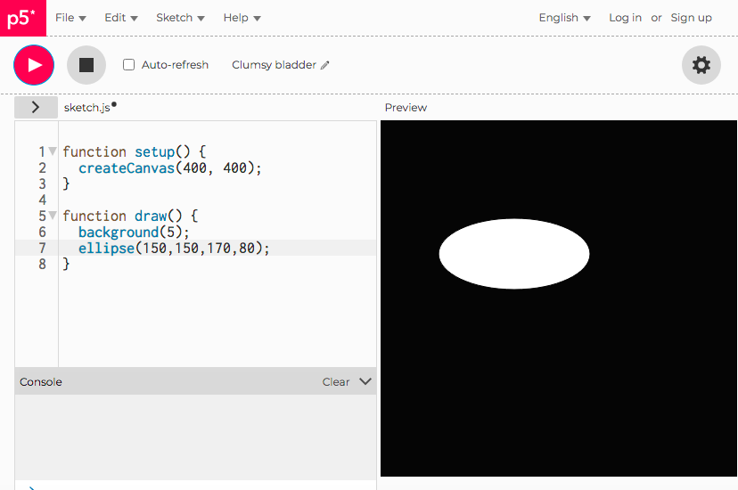
SAMPLE PROJECT 1 CODE:
1. function setup() {
2. createCanvas(400, 400);
3. }
4.
5. function draw() {
6. background(5);
7. ellipse(150,150,170,80);
8. }

Slide 26
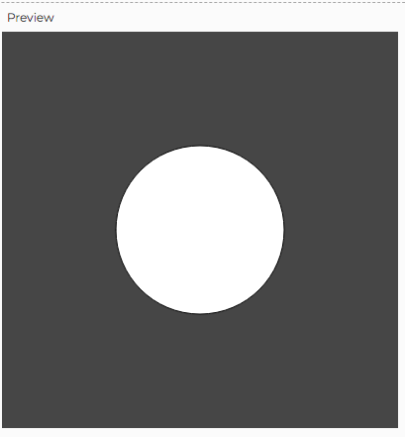
DEBUGGING TIPS/CHALLENGE PROJECT 1:
QUESTION:
How can the following snippet of code be debugged to create the following image in the preview workspace?
1. function setup() {
2. createCanvas(400, 400);
3. }
4.
5. function draw() {
6. background(70);
7. ellipse(150,150,170,80);
8. }

Slide 27
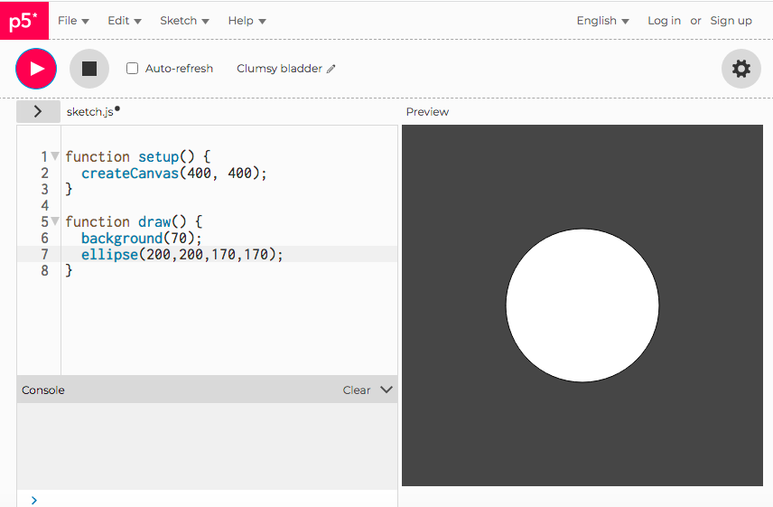
DEBUGGING TIPS/CHALLENGE PROJECT 1 SOLUTION:

Slide 28
PROJECT 1 CODE SNIPPET:
LOCATION of the SHAPE
On the CANVAS
DIMENSIONS
(WIDTH & HEIGHT) Of SHAPE CREATED
square(150,250,100)
EXPLANATION:
A square at location (150, 25) with a side size of 100.

Slide 29
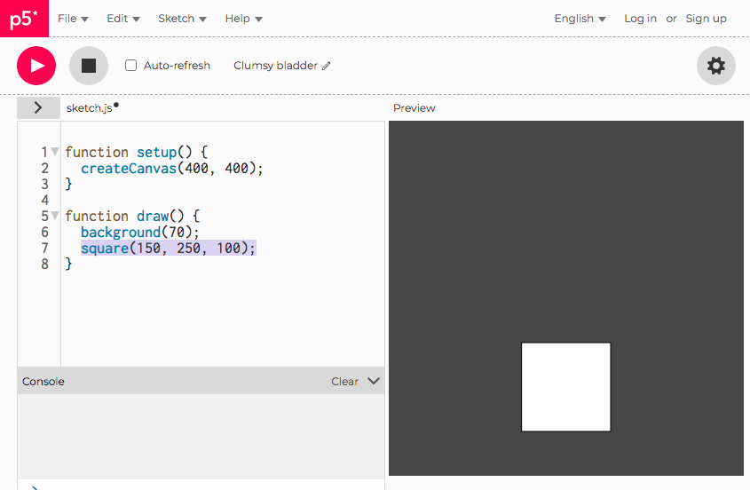
SAMPLE PROJECT 1 CODE:
1. function setup() {
2. createCanvas(400, 400);
3. .}
4.
5 .function draw() {
6. background(70);
7. square(150, 250, 100);
8. }

